Slide 1
K-Means
Class Algorithmic Methods of Data Mining
Program M. Sc. Data Science
University Sapienza University of Rome
Semester Fall 2015
Lecturer Carlos Castillo http://chato.cl/
Sources:
Mohammed J. Zaki, Wagner Meira, Jr., Data Mining and Analysis: Fundamental Concepts and Algorithms, Cambridge University Press, May 2014. Example 13.1. [download]
Evimaria Terzi: Data Mining course at Boston University http://www.cs.bu.edu/~evimaria/cs565-13.html

Slide 2

The k-means problem
Boston University Slideshow Title Goes Here
consider set X={x1,...,xn} of n points in R^{d}
assume that the number k is given
problem:
    find k points c1,...,ck (named centers or means)
  so that the cost
  is minimized

Slide 3
The k-means problem
k=1 and k=n are easy special cases (why?)
an NP-hard problem if the dimension of the data is at least 2 (d≥2)
in practice, a simple iterative algorithm works quite well
Boston University Slideshow Title Goes Here

Slide 4
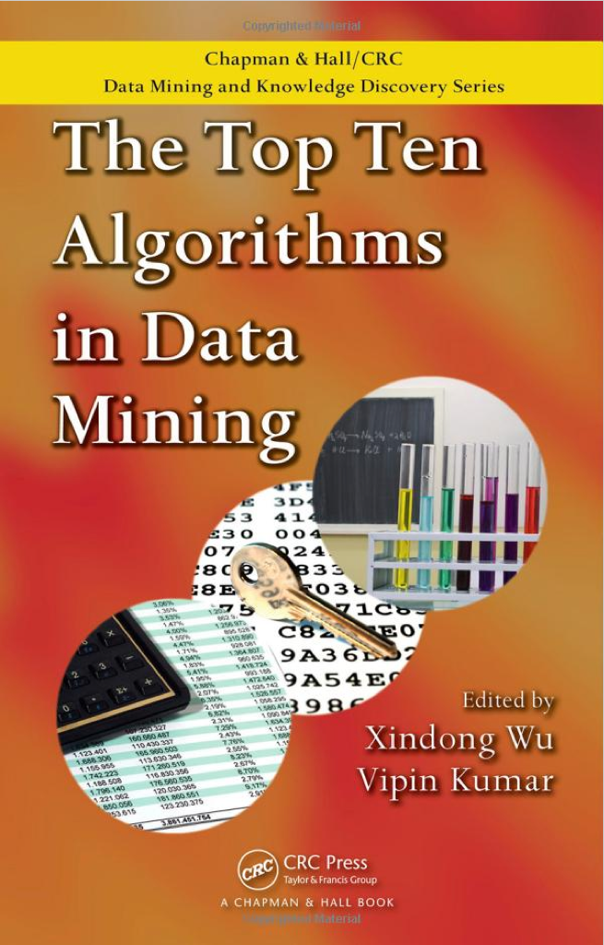
The k-means algorithm
Boston University Slideshow Title Goes Here
voted among the top-10 algorithms in data mining
one way of solving the k-means problem

Slide 5
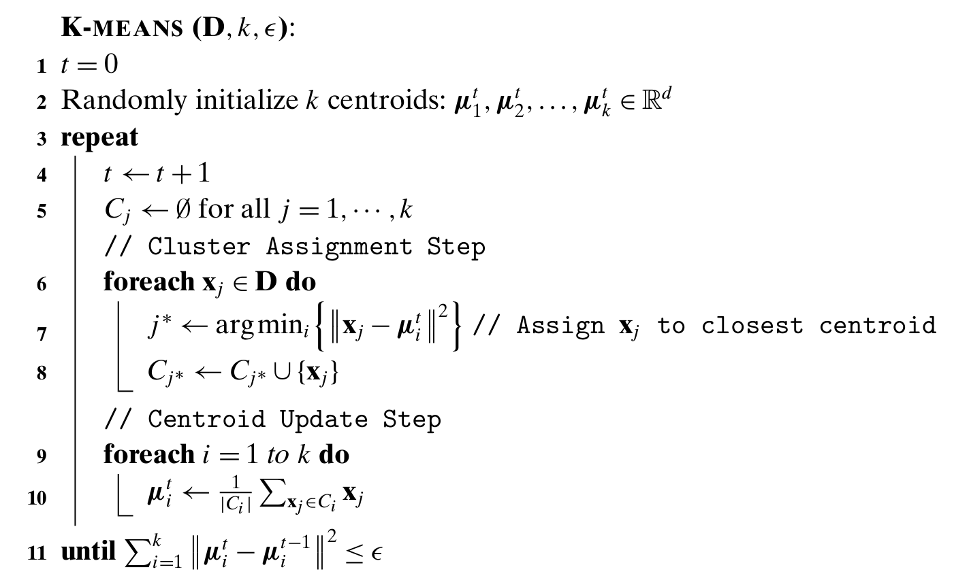
K-means algorithm

Slide 6
The k-means algorithm
Boston University Slideshow Title Goes Here
randomly (or with another method) pick k cluster centers {c1,...,ck}
for each j, set the cluster Xj to be the set of points in X that are the closest to center cj
for each j let cj be the center of cluster Xj
(mean of the vectors in Xj)
repeat (go to step 2) until convergence

Slide 7
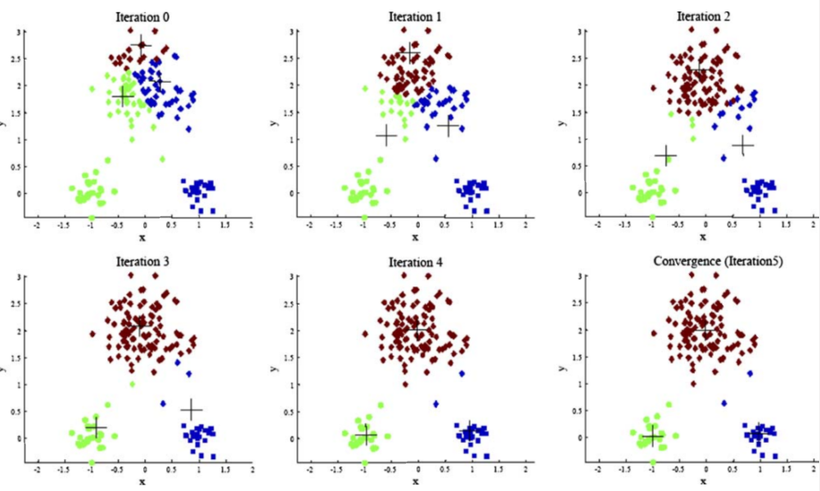
Sample execution
Boston University Slideshow Title Goes Here

Slide 8
1-dimensional clustering exercise
Exercise:
For the data in the figure
  Run k-means with k=2 and initial centroids u1=2, u2=4 (Verify: last centroids are 18 units apart)
Try with k=3 and initialization 2,3,30
http://www.dataminingbook.info/pmwiki.php/Main/BookDownload Exercise 13.1

Slide 9
Limitations of k-means
Clusters of different size
Clusters of different density
Clusters of non-globular shape
Sensitive to initialization

Slide 10
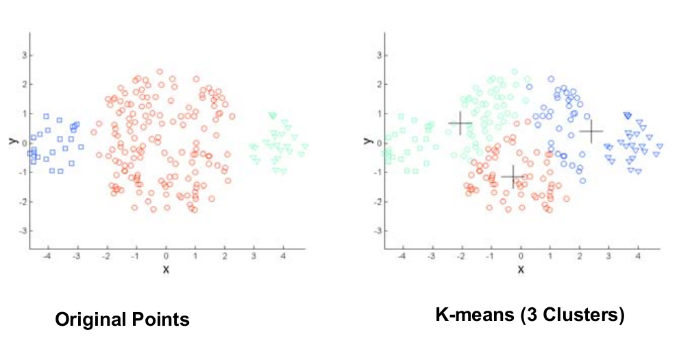
Limitations of k-means: different sizes
Boston University Slideshow Title Goes Here

Slide 11
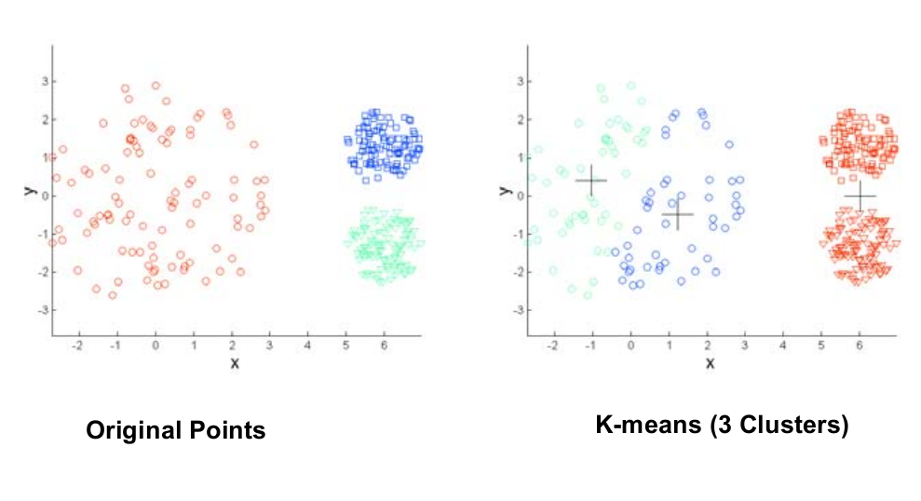
Limitations of k-means: different density
Boston University Slideshow Title Goes Here

Slide 12
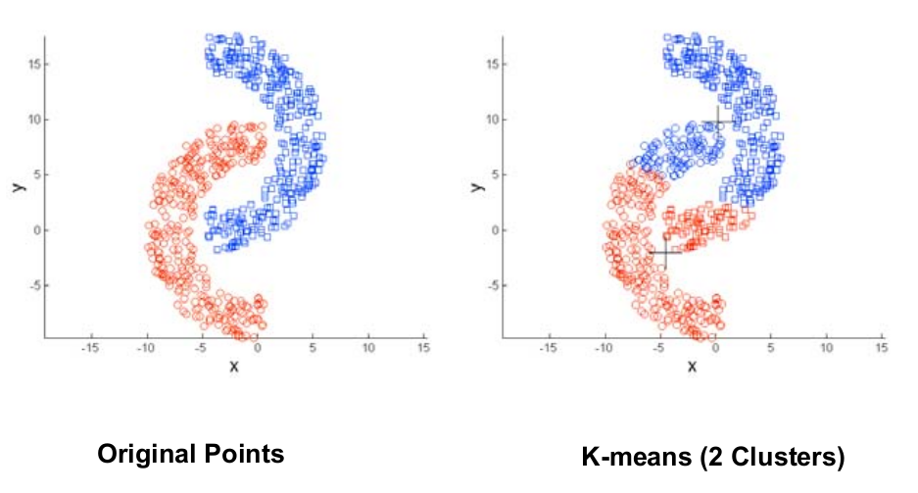
Limitations of k-means: non-spherical shapes
Boston University Slideshow Title Goes Here

Slide 13
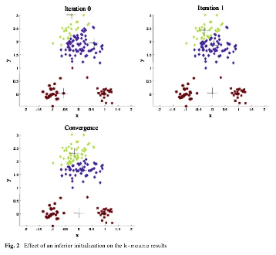
Effects of bad initialization
Boston University Slideshow Title Goes Here

Slide 14
k-means algorithm
Boston University Slideshow Title Goes Here
finds a local optimum
often converges quickly
  but not always
the choice of initial points can have large influence in the result
tends to find spherical clusters
outliers can cause a problem
different densities may cause a problem

Slide 15
Advanced: k-means initialization

Slide 16
Initialization
Boston University Slideshow Title Goes Here
random initialization
random, but repeat many times and take the best solution
  helps, but solution can still be bad
pick points that are distant to each other
  k-means++
  provable guarantees

Slide 17
k-means++
Boston University Slideshow Title Goes Here
David Arthur and Sergei Vassilvitskii
k-means++: The advantages of careful seeding
SODA 2007

Slide 18
k-means algorithm: random initialization
Boston University Slideshow Title Goes Here

Slide 19
k-means algorithm: random initialization
Boston University Slideshow Title Goes Here

Slide 20
k-means algorithm: initialization with further-first traversal
Boston University Slideshow Title Goes Here
2
1
3
4

Slide 21
k-means algorithm: initialization with further-first traversal
Boston University Slideshow Title Goes Here

Slide 22
but... sensitive to outliers
Boston University Slideshow Title Goes Here
2
1
3

Slide 23
but... sensitive to outliers
Boston University Slideshow Title Goes Here

Slide 24
Here random may work well
Boston University Slideshow Title Goes Here

Slide 25
k-means++ algorithm
interpolate between the two methods
let D(x) be the distance between x and the nearest center selected so far
choose next center with probability proportional to
(D(x))ª = Dª(x)
Boston University Slideshow Title Goes Here
a = 0 random initialization
a = ∞ furthest-first traversal
a = 2 k-means++

Slide 26
k-means++ algorithm
initialization phase:
  choose the first center uniformly at random
  choose next center with probability proportional to D²(x)
iteration phase:
  iterate as in the k-means algorithm until convergence
Boston University Slideshow Title Goes Here

Slide 27
k-means++ initialization
Boston University Slideshow Title Goes Here
3
1
2

Slide 28
k-means++ result
Boston University Slideshow Title Goes Here

Slide 29
k-means++ provable guarantee
Boston University Slideshow Title Goes Here
approximation guarantee comes just from the first iteration (initialization)
subsequent iterations can only improve cost

Slide 30
Lesson learned
Boston University Slideshow Title Goes Here
no reason to use k-means and not k-means++
k-means++ :
  easy to implement
  provable guarantee
  works well in practice

Slide 31
k-means--
Algorithm 4.1 in [Chawla & Gionis SDM 2013]

